Slide 1
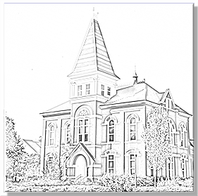
DegreeWorks and the Graduate Plan of Study Auburn University Graduate School
Presented to: Chemical Engineering Department
SPRING 2018

Slide 2
The Policy
https://sites.auburn.edu/admin/universitypolicies/Policies/PlanofStudyPolicy.pdf
Early in the graduate program, each student should confer with the appropriate departmental advisor or major professor to select courses and discuss research interests. Then a Plan of Study should be prepared and submitted to the Graduate School. The Plan of Study form is completed using DegreeWorks. The Plan of Study must be submitted at least one term prior to the term in which the student plans to Graduate. No student will be permitted to graduate who fails to submit a Plan of Study. Revisions to existing Plans of Study are also completed in DegreeWorks. Notification of all changes must be provided before the beginning of the final semester. The student is responsible for carrying out the planned program and for asking the major professor to make necessary changes.

Slide 3
The Process
DegreeWorks: https://dw.auburn.edu
Instructions: http://graduate.auburn.edu/current-students/degreeworks-plan-of-study
How does it work?
DegreeWorks has been “scribed” by the Graduate School to understand each program’s requirements, one of which is a Plan of Study, or “Planner Block”.
Electives and other customizations which comprise the Plan of Study are entered on a Planner in DegreeWorks by the student, and must be approved by the student’s committee and the Graduate School.
The student’s progress toward the requirements is continually updated in DegreeWorks for use by the student and/or advisor.
The program’s scribed requirements and the Planner are used by the Graduate School to clear the student for graduation.

Slide 4
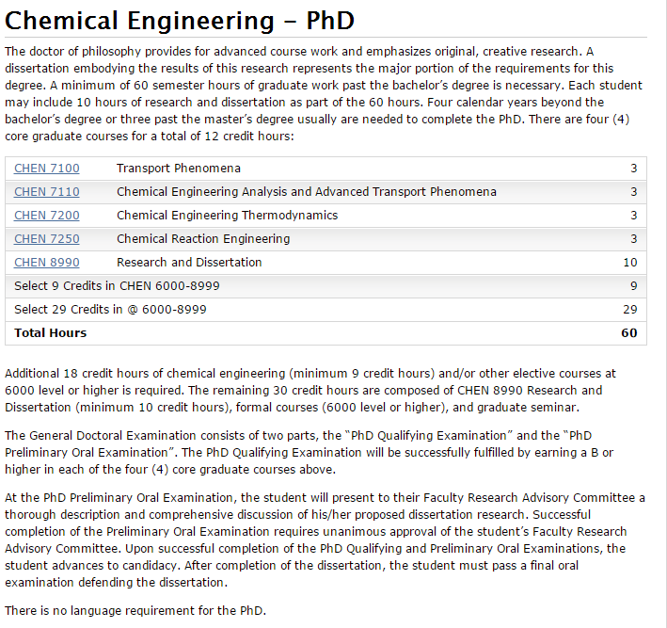
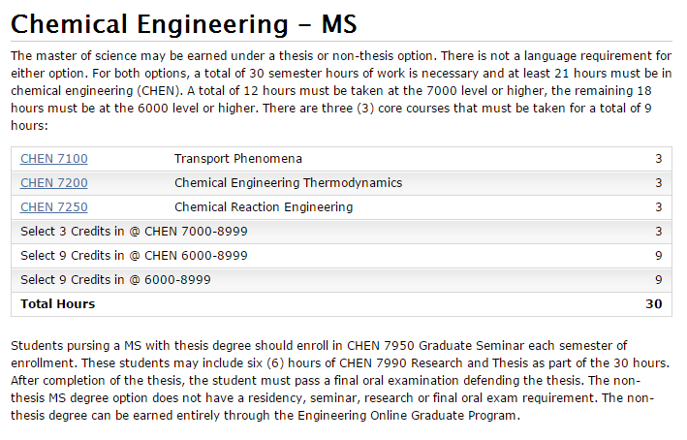
The Program (http://bulletin.auburn.edu)

Slide 5
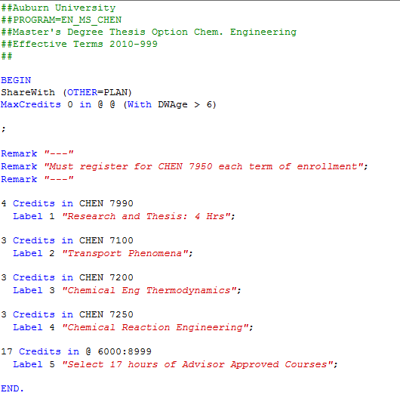
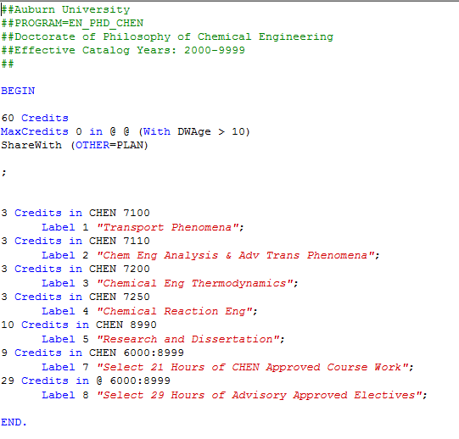
The Scribed Rules

Slide 6
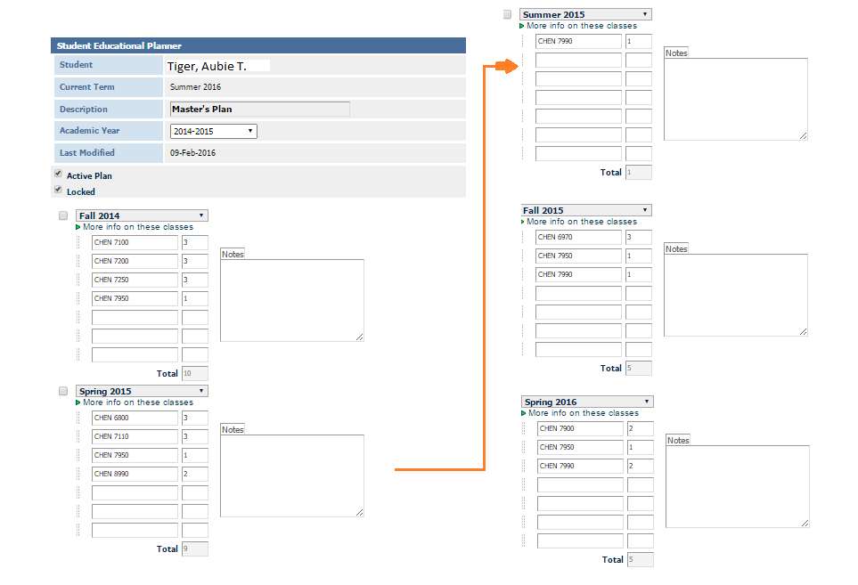
The DegreeWorks Planner

Slide 7
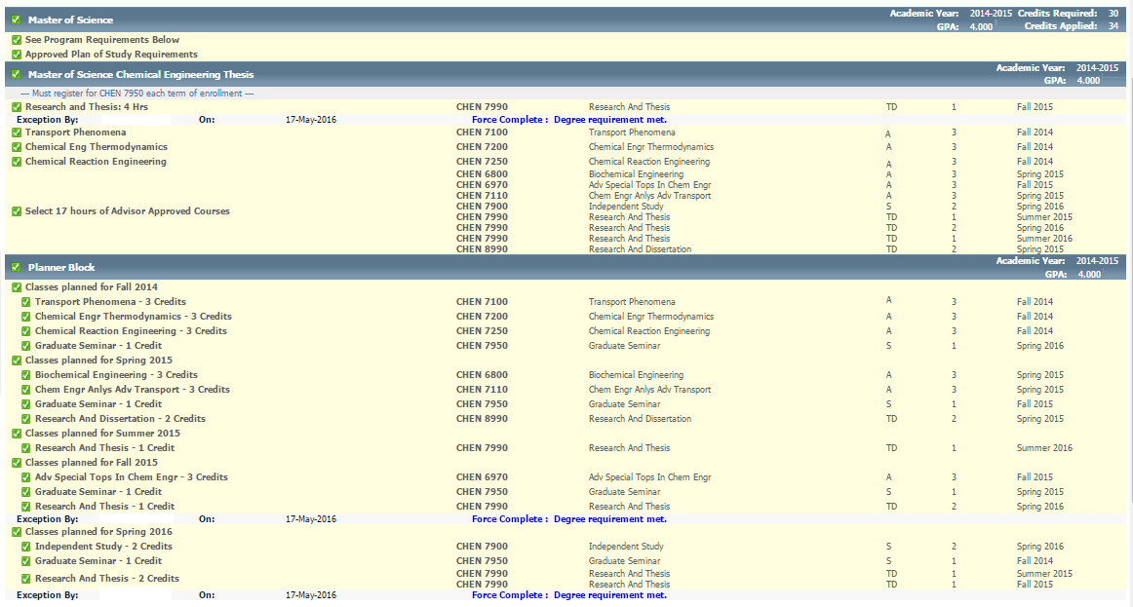
The DegreeWorks Audit

Slide 8
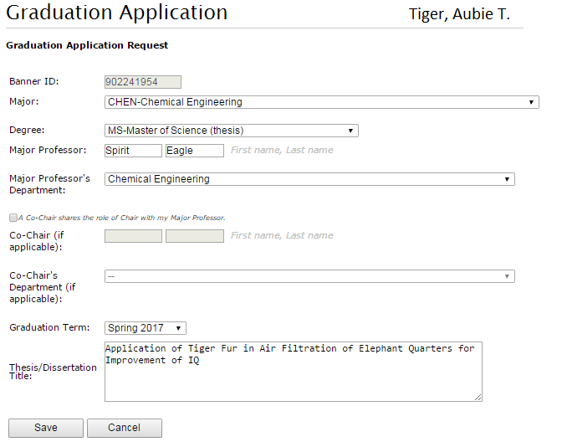
The Graduation Check
One term before graduation,
the student must fill out a
Graduation Application.
AU Access, My Academics tab
The Graduate School staff will use
DegreeWorks to verify that program
requirements have been met.

