Slide 1
An Evaluation of the Affordable Care Act
Todd Easton
Pamplin School of Business
Slides under Recent Posts at:
sites.up.edu/easton/

Slide 2
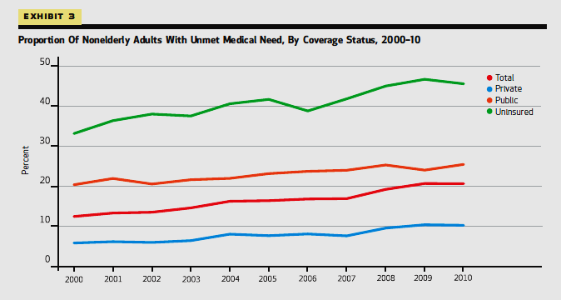
Unmet Medical Need by Health Insurance Coverage, 2000 to 2010
Genevieve M. Kenney, Stacey McMorrow, Stephen Zuckerman, and Dana E. Goin, “A Decade Of Health Care Access Declines For Adults Holds Implications For Changes In The Affordable Care Act,” Health Affairs, May 2012

Slide 3
3 ACA Achievements

Slide 4
1) Declining percent uninsured
Year | All Ages | 18-64
2010 | 16.0% | 22.3%
2016 | 8.8% | 12.3%
Percentage-point decline | 7.2 | 10.0
“Health Insurance Coverage: Early Release of Estimates From the National Health Interview Survey, January–September 2016,” Michael E. Martinez, Emily P. Zammitti, and Robin A. Cohen, Division of Health Interview Statistics, National Center for Health Statistics

Slide 5
2) Increased access for those with pre-existing conditions
By:
Forbidding exclusions
Requiring community rating

Slide 6
3) Improved health insurance policies
No annual benefit limits
Broad set of covered benefits
e.g. pregnancy care, contraception, substance abuse treatment

Slide 7
2 ACA Disappointments
1) Smaller-than-projected declines uninsured population

Slide 8
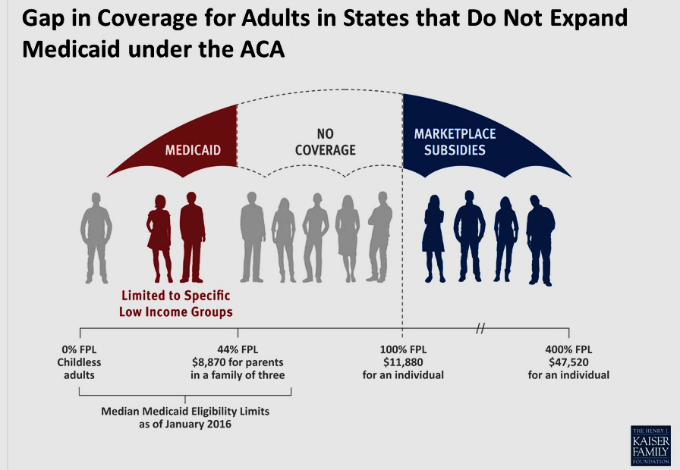
Rachel Garfield and Anthony Damico, “The Coverage Gap: Uninsured Poor Adults in States that Do Not Expand Medicaid,” Kaiser Family Foundation, Oct. 2016
19 States Did Not Expand Medicaid

Slide 9
2) Decreased choice on health insurance exchanges

Slide 10
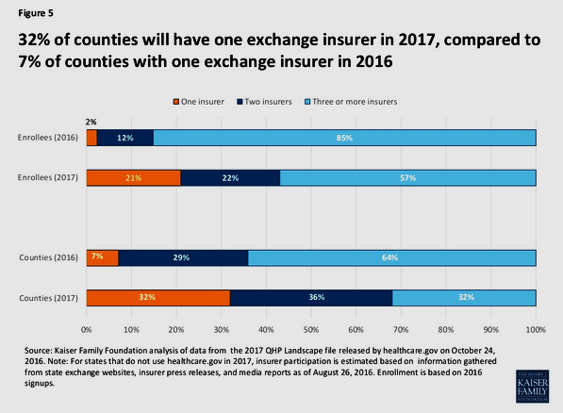

Slide 11
Slow growth in medical prices

