Slide 1
Teaching
Rising Income Inequality

Slide 2
Possible Research Resources (A to H)
American Enterprise Institute for Public Policy Research (Click on “Poverty Studies” or “Economics.” Alternatively, use search engine to find relevant research. For example, try searching on “income inequality."
Brookings Institution, Income Inequality and Social Mobility (Also, try searching on related topics: for example “workforce development” or “taxation.”)
Cato Institute
Center on Budget and Policy Priorities, Poverty and Inequality (Also, try searching on: “earned-income tax credit,” “progressive tax,” or “regressive tax.”)
Citizens for Tax Justice, Tax Reform Options (Also, click on “State Tax Issues.”)
Commonwealth Fund (Good on health care for low-income families) Hamilton Project, Economic Security and Poverty (Also, click on “Topics” and then on “Employment and Wages” or “Tax Policy and Budget”)
Heritage Foundation, Poverty and Inequality (Also, click on “Issues” and then on “Welfare and Welfare Spending”)

Slide 3
Possible Research Resources (I to W)
Institute for Research on Poverty
Institute for Women's Policy Research
Kaiser Family Foundation
National Poverty Center
The Stanford Center for the Study of Poverty and Inequality
Urban Institute U.S. Census Bureau, Income & Poverty
Washington Center for Equitable Growth
W.E. Upjohn Institute for Employment Research World Wealth and Incomes Database

Slide 4
Good Readings for Beginners
Income inequality over time: causes & consequences
Candela Open Courses, “Income Inequality: Measurement and Causes,” 2014
  -Quintile shares, household composition, supply and demand for high skill labor
Steven J. Markovich, “The Income Inequality Debate,” Council on Foreign Relations Backgrounder, February 3, 2014
  -The top 1%, globalization, de-unionization, education and technological change
Brad Plummer, “Is inequality bad for economic growth?”, The Washington Post, December 5, 2013
  -Investing too little in education & the financial crisis and the demand for cheap credit

Slide 5
Research Questions for Students
Measurement
How does correcting for changes in family size affect the rise in inequality?
How does correcting for changes in the tax system affect the rise in inequality?
How does correcting for changes in the transfer system affect the rise in inequality?
Causes
How do health inequalities contribute to income inequality?
How much has increasing international trade contributed to rising income inequality?
Consequences
How much do rises in income inequality reduce mobility between generations?
Does rising inequality slow economic growth or speed it up?
Does rising inequality increase or decrease average happiness?

Slide 6
Research Questions for Students, Continued
Responses
How can we make US vocational education more effective?
How can we most effectively increase the education levels achieved by children from low-income families?
How can we improve college graduation rates for first-generation students and students from low-income families?
How can we most effectively reduce labor market discrimination? (for example, against women or African Americans)
Is a rise in the minimum wage an effective response to income inequality? If it is, how high should it go?
If we were to make transfers to low-income families more generous, what would be the most effective way to do that?
What would be the most effective way to increase the proportion of children in two-parent families?

Slide 7
Understanding Quintiles

Slide 8
Quintile Income Shares

Slide 9
Quintile Income Shares

Slide 11
An Exercise to Help Students Understand 2012 Quintiles & their Boundaries
10 Students Represent the Household Income Distribution

Slide 12
Percentiles of the US Household Income Distribution
in 2012

Slide 13
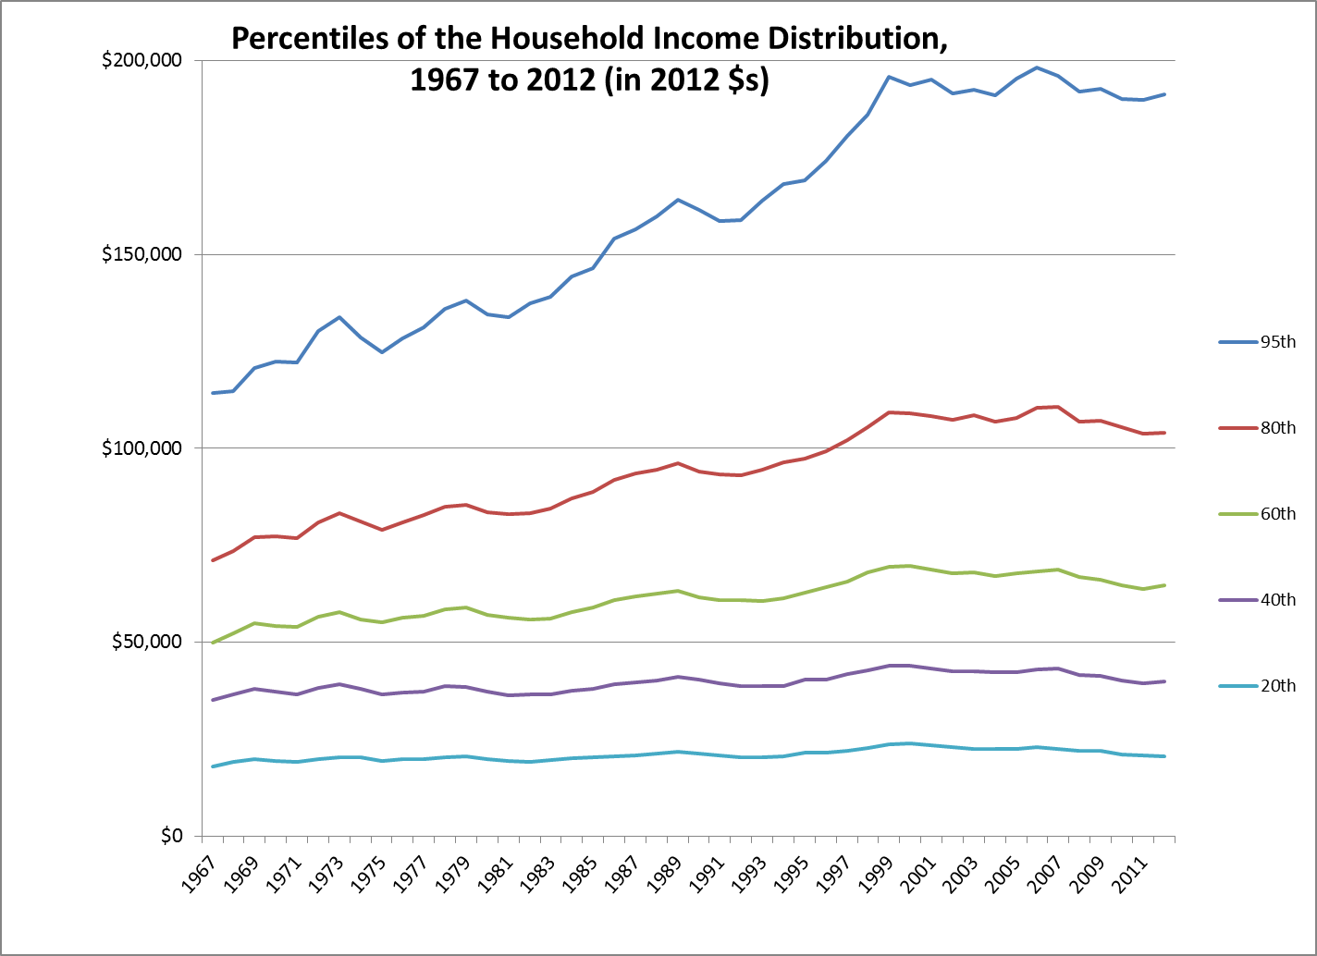

Slide 14
Measuring the Change in Inequality from 1968 to 2012,
Part I

Slide 15
Measuring the Change in Inequality from 1968 to 2012,
Part II

Slide 16
Changes in Quintile Income Shares
1968 to 2015

Slide 17
Growth in Income Share of
Top Quintile and Top 5%

Slide 18
Causes of Rising Income Inequality Among US Households
Changes in household composition
For example, think about how changes in the fifth quintile and changes in the first quintile, might have contributed to the rise:
  An increasing share of households in the fifth quintile are two-earner households, which raises their income relative to households in the first quintile.
  An increasing share of households in the first quintile are one-parent households, most of them headed by women. Such households tend to be low income because they have only one earner, because that earner needs a job with flexible hours (if her/his children are young), and because of labor-market discrimination (if the household head is a woman).

Slide 19
2) Technological change and rising demand for skill
  The wages of college graduates grew, while the wages of high school graduates grew slowly (women) or shrank (men)…so the gap between “college wages” and “high school wages” increased.
  Why? One reason: computers and new management strategies meant that firms rapidly increased their employment of college-educated workers. More people were graduating college each year, but that growth was slow compared to the growth in employment. The resulting shortage pushed up “college wages” quickly.

Slide 20
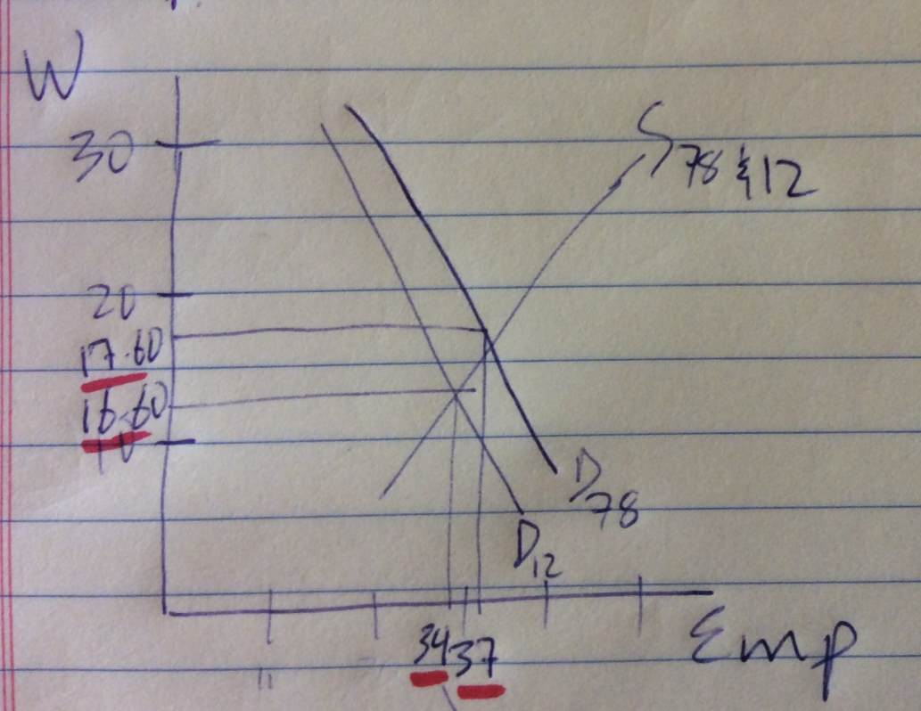
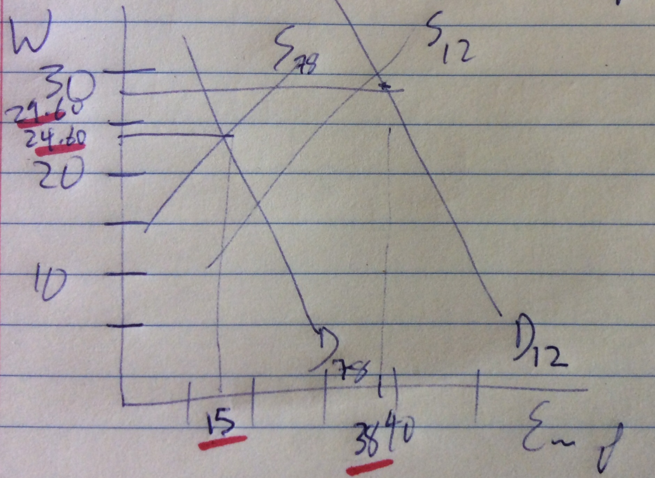
Rising Demand for Skill
The Market for Workers with Just a High School Degree
The Market for Workers with Just a College Degree
Wages are 2015 dollars per hour. Employment is in millions of workers. The employment levels for workers with just a college degree are approximate.

Slide 21
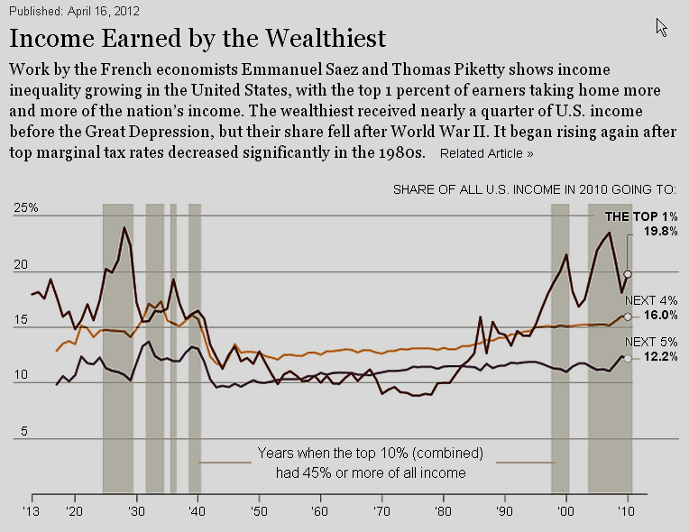

Slide 22
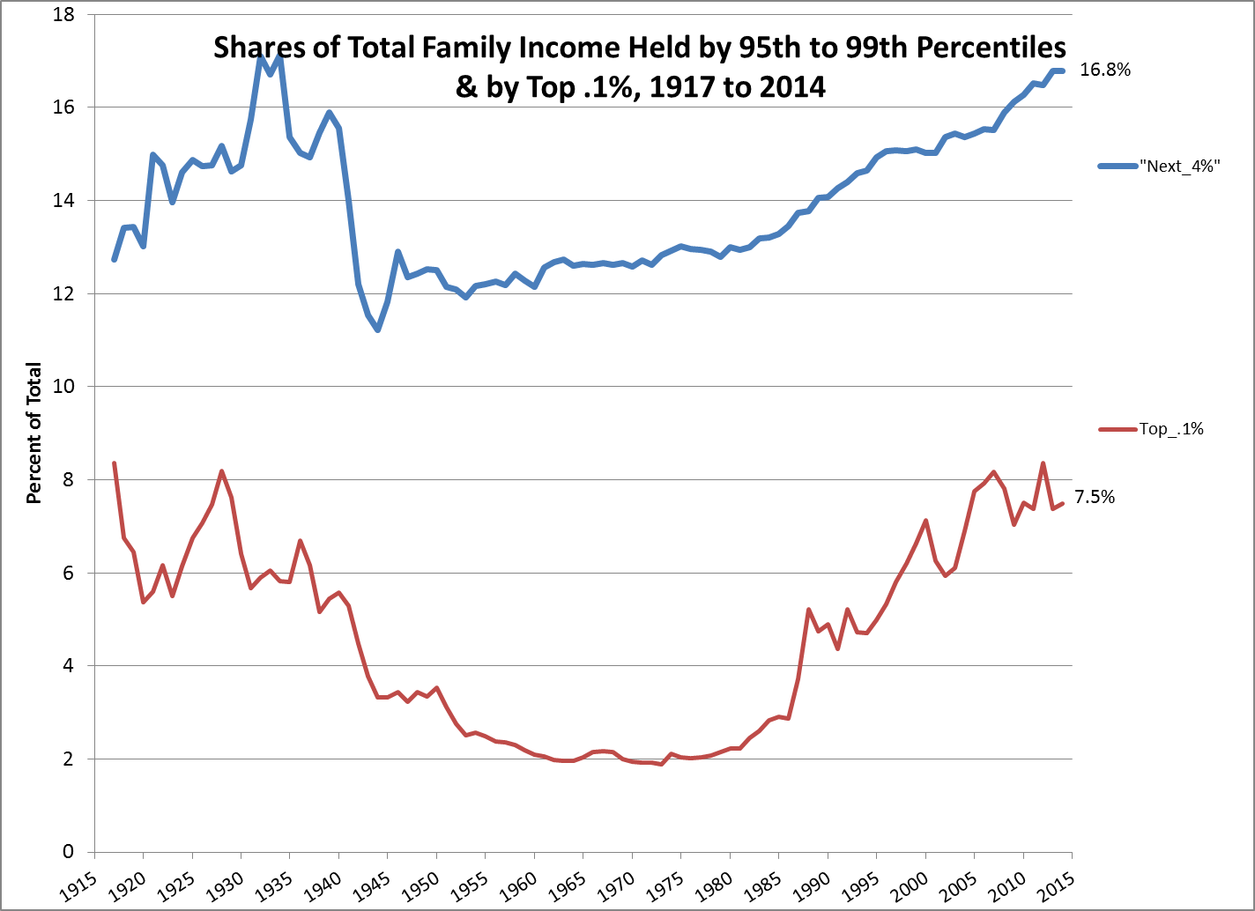
Analysis by Emmanue l Saez, Excel workbook downloaded from
World Wealth and Income Database 8/29/16

Slide 23
Growth in Income Share of
Top 1% and Top .1%

Slide 24
3) Rising CEO compensation & rising salaries in finance
  These are the two groups that contributed most to the rise in average incomes among households in the top .1%.

Slide 25
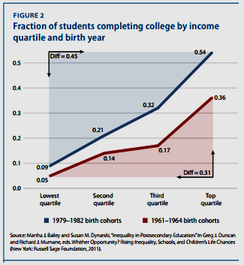
Possible Links Between Rising Inequality and Macroeconomic Health (From the Brad Plummer article on Slide 3)
1) Inequality reduces household investments in education
…and slower improvement of education levels means slower growth in productivity and real incomes. Remember, one of the four biggest contributors to productivity growth is improvement in human capital.

Slide 26
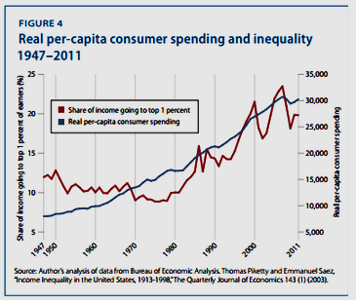
Links Between Rising Inequality and Macroeconomic Health
2) Rising inequality reduces consumption
Oh…but consumer spending actually seemed to keep up just fine!
But maybe that’s because lower-quintile households were increasing their spending by borrowing…which brings us to the next slide.

Slide 27
Links Between Rising Inequality and Macroeconomic Health
3) Rising inequality increases household borrowing & debt
This actually is part of what happened in the years before the Great Recession. Many households borrowed against their homes, increasing their debt.
When house prices dropped and the economy slid into the recession, many households lost their homes, but were stuck with the debt.
High debt levels have held back consumer spending, especially in parts of the country that experienced the biggest boom in house prices.
Slow growth in consumer spending since 2009 has kept GDP growth slow.

