Slide 1
LED Mirror
Kian sadjadi, Jim Rowe, Dalton faker, Nathan lee

Slide 2
The team
University or Portland
11/15/2019
Dalton Faker (Team Lead)
Jim Rowe (Project Lead)
Kian Sadjadi (Scribe)
Nathan Lee (Webmaster)
Faculty advisor:
Dr. Peter Osterberg
Industry Advisor:
Matt Clark (Intel)

Slide 3
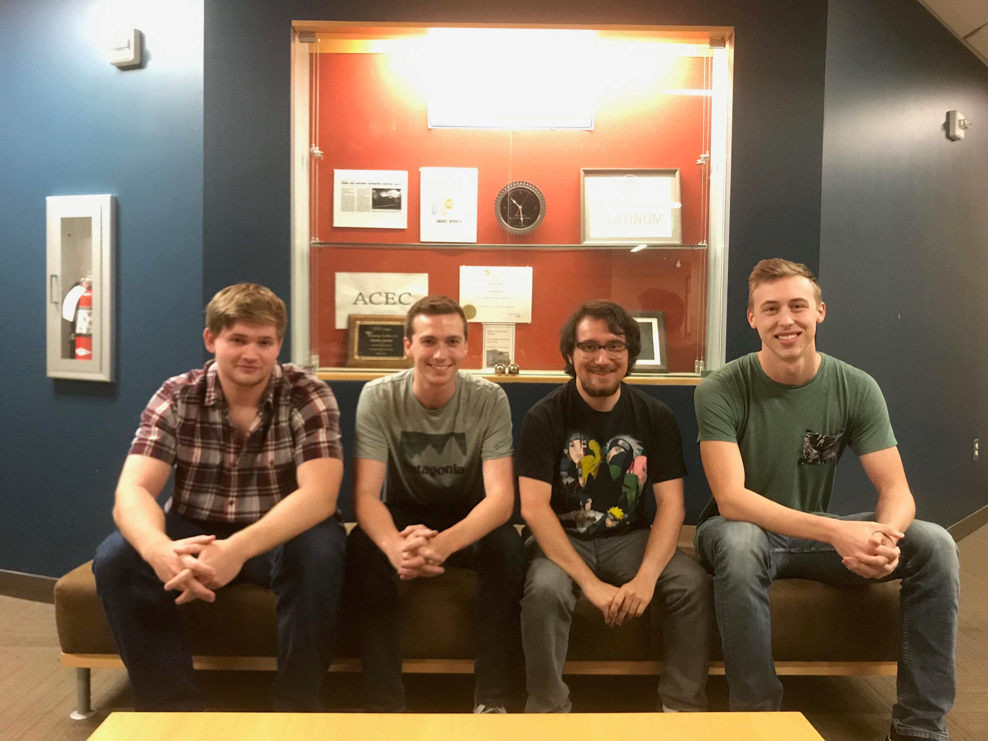
Meet The team (left to right)
Jim Rowe: Project lead, in charge of the ASIC functionality
Nathan Lee: Webmaster, In charge of the website and Arduino sensor interface
Kian Sadjadi: Scribe, In charge of the LED array and all presentations
Dalton Faker: Team lead, In charge of the sensor selection and array

Slide 4
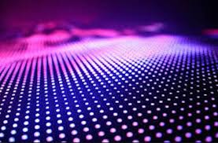
Project overview
An interactive board of LED’s mirroring objects in front of them
Uses LED, UV sensors,
Arduino and an FPGA

Slide 5
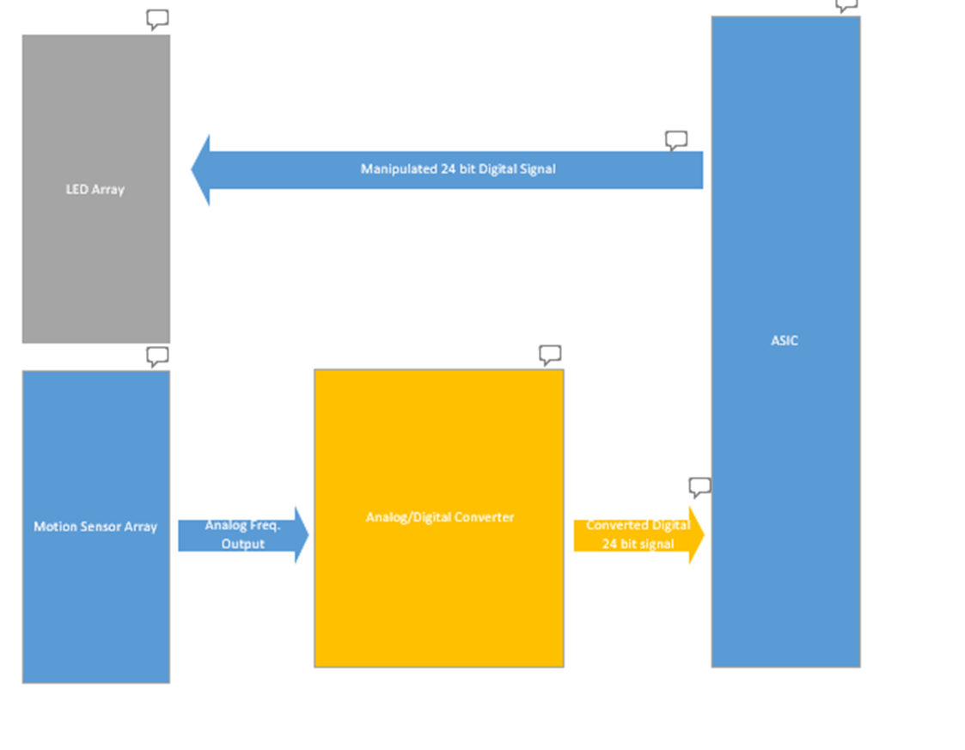
Block diagram

Slide 6
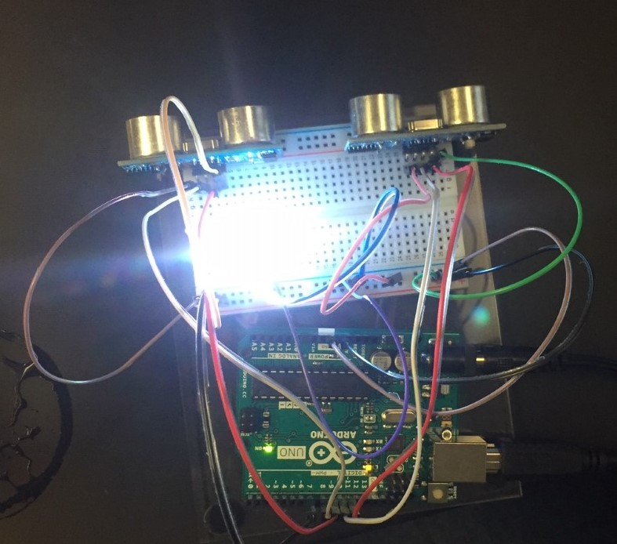
milestones
Project proposal Submitted
Project proposal approved
Testing sensors and lights
Completed Functional Spec V1
Completed Design Dock V1
Website up and running

Slide 7
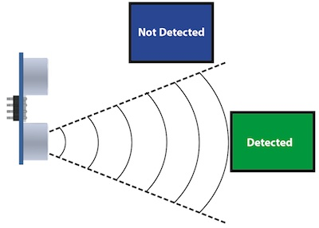
Issues/concerns
Interfacing issues between sensors and ASIC
Wiring and connections between sensors and lights
Timing for Master/Slave components

Slide 8
Important Decisions
Select style of sensor for project
Solve interfacing issues between sensors and Arduino
Solve interfacing issues between FPGA and LED’s
Order parts
Test components individually

Slide 9
Changes since last presentation
Changed sensors
Switched roles of FPGA and Arduino
Budget Approved
Ordered Parts

Slide 10
Conclusion
Project is on schedule.
Functional design is mostly complete.
Component showcase and small scale model intended to show functionality.
Questions?

