Slide 1
An Analytical Study of
Mark Mathabane’s Kaffir Boy
Leslie Ramirez & Fabien Achinda

Slide 2
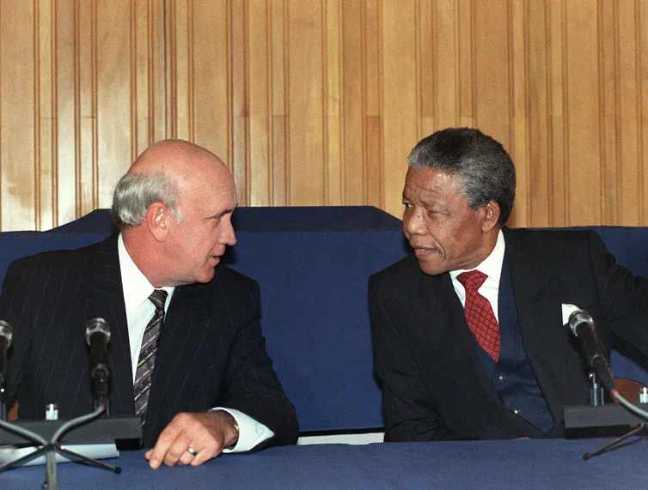
Apartheid
“Apartheid,” meaning “appartness” stems from Afrikaans, a language commonly spoken in South Africa.
“A system of legislation that upheld segregationist policies against non-white citizens of South Africa.” (History)
“Kaffir” → “Infidel” in Arabic, synonymous with the hard “r” in South Africa

Slide 3
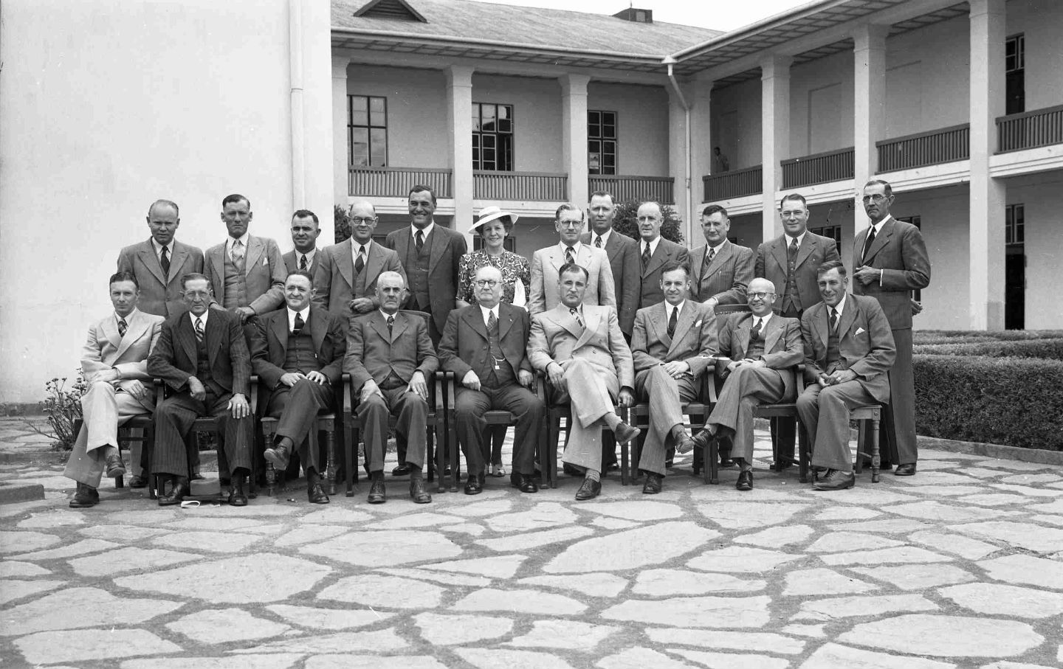
Apartheid Legislations and Acts:
1913: The Land Act of 1913
1948: National Party attains power in South Africa
Social norms legalized(“Apartheid becomes law”)
1950: The Population Restriction Act
Classification via race(carrying of passes at all times for non-whites)
Separation of families
Double downing on the Prohibition of Mixed Marriages Act of 1949
1952-55: Opposition to Apartheid forms
African National Congress
Burning of the pass books
Freedom Charter
1959: Bantu Self Government Act of 1959
Created 10 homelands known as “Bantustans”
Dive and conquer

Slide 4
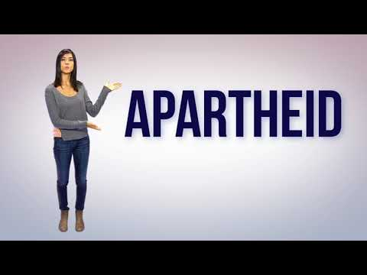
Apartheid

Slide 5
Lived Experienced: Fear
“The police were smashing it, and if I didn’t open it their anger would know no bounds once they got in; I remembered well how they beat me up the last time” (17)
Constant paranoia surrounding raids or the collecting of passbooks
Number Four and Moderbee
Use of tribal members as raid officials
~Willing to comply
~Exploiting hatred between tribes/regions

Slide 6
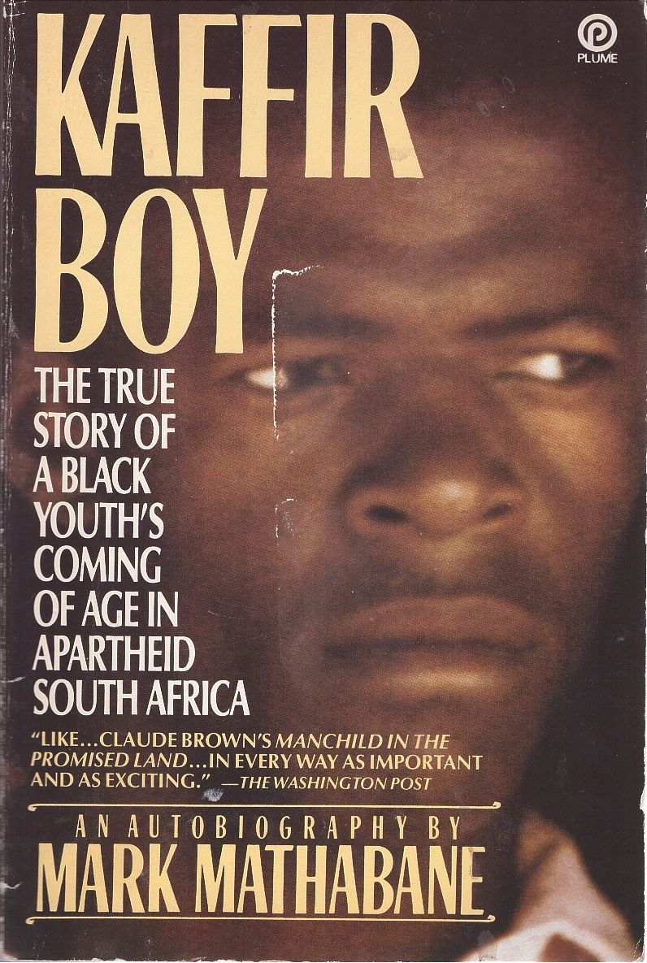
Lived Experienced: Violence
“As the wounded man staggered past me, I detected tubelike things unwinding like a spool of thread through his slashed overalls” (163)
Disregard for human life due to seeing the people of the ghetto as inept
The cyclical nature of violence
Due to raging discrimation, mistreatment was overlooked
~Those with a sliver of power abused it

Slide 7
Lived Experienced: Economic Disparities
“Their bodies were covered with sores, which punctured and oozed pus, and their hair turned to a strange orange color” (38)
Job scarcity led to hunger and desperation
~Mathabane’s father was detained for roughly 6 months
Being unemployed was seen as a grave crime punishable by torture, private labor, or detainment
Indescribable struggles of the poor
→ Johannesburg Reef, natural resources were targeted

Slide 8
Lived Experienced: Grit
“She had no money for maternity care and diapers, so she continued working until the babe was born” (205)
Mathabane’s mother refused to give up when it came to providing for the family
~All odds were against her
The refusal to remain complacent
Education
Religion
Remaining steadfast on economic and social stability goes a long way

Slide 9
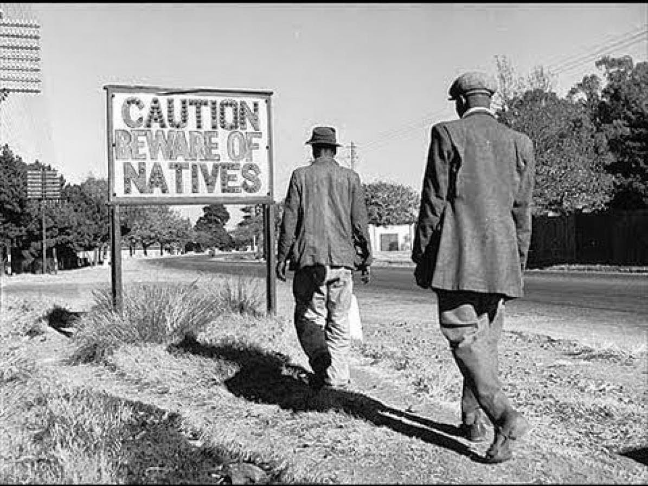
Appeal to Pathos
Mathabane saw how apartheid was acknowledged but the reality disregarded
Graphic depictions of murder, child prostitution, and starvation
Dealing with a crowd that has been conditioned to look the other way
Although retelling is uncomfortable, that was the ultimate goal

Slide 10
Passport to Freedom: How Mathabane Got Lucky
Received tennis training by professionals and dedicated time to developing style
Granted opportunities to play in tournaments which caught attention
~Scouted by American schools
Allowed to escape state of apartheid and see how the rest of the world functions
Not everyone had the talent to be recognized and supported in their training
Few allowed to receive an education
→ Gorbachev’s interest in Glasnost and Perestroika strayed away the Russians from Southern Africa

Slide 11
Discussion Questions:
How far has South Africa come since the official end of Apartheid in 1993?
Has come a long way
Has not come a long way
Measure of progress
?

Slide 12
Sources
FW de Klerk made a speech 31 years ago that ended apartheid: why he did it (theconversation.com)
Kaffir Boy by Mark Mathabane - Paperback - 1987 - from Range & River Books (SKU: 41031) (biblio.com)
Wide Asleep in America: Defending Apartheid: Then in South Africa, Now in Palestine
Apartheid Explained - YouTube
https://www.thenation.com/wp-content/uploads/2015/06/south_africa_national_party_cc_img.jpg
81JarTViupL.jpg

